Slide 1
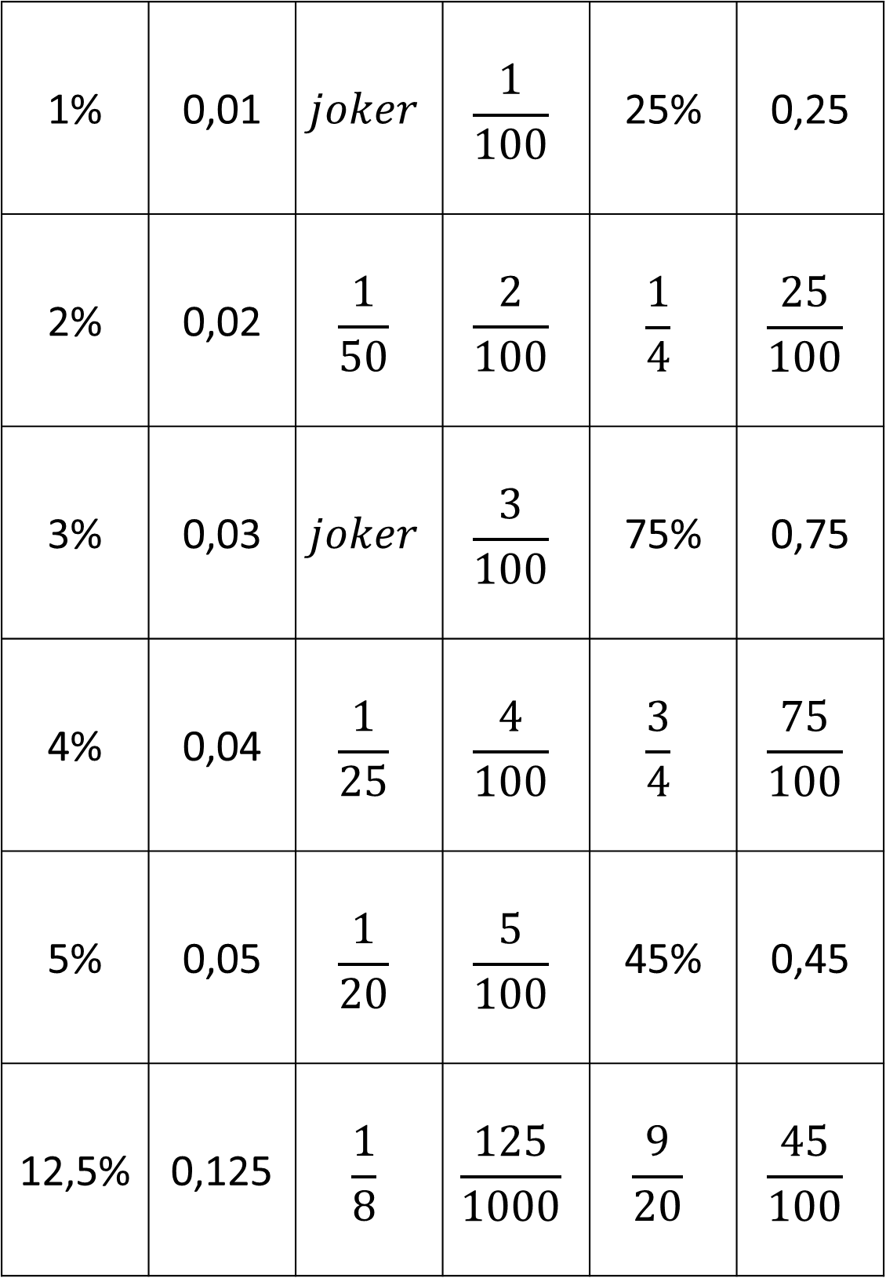
1% | 0,01 | $$joker$$ | $$\frac{1}{100}$$ | 25% | 0,25
2% | 0,02 | $$\frac{1}{50}$$ | $$\frac{2}{100}$$ | $$\frac{1}{4}$$ | $$\frac{25}{100}$$
3% | 0,03 | $$joker$$ | $$\frac{3}{100}$$ | 75% | 0,75
4% | 0,04 | $$\frac{1}{25}$$ | $$\frac{4}{100}$$ | $$\frac{3}{4}$$ | $$\frac{75}{100}$$
5% | 0,05 | $$\frac{1}{20}$$ | $$\frac{5}{100}$$ | 45% | 0,45
12,5% | 0,125 | $$\frac{1}{8}$$ | $$\frac{125}{1000}$$ | $$\frac{9}{20}$$ | $$\frac{45}{100}$$

Slide 2
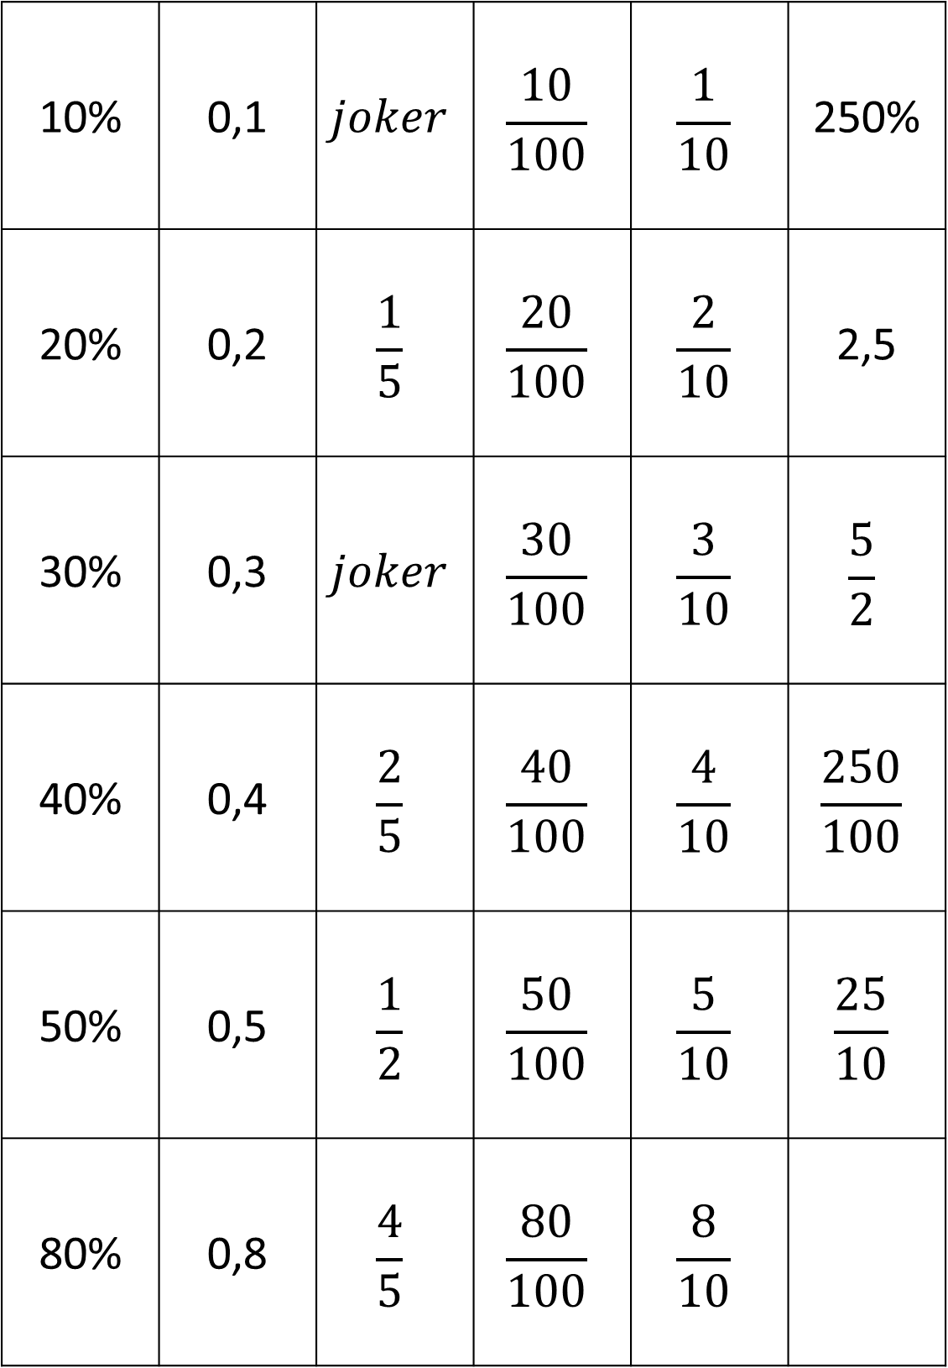
10% | 0,1 | $$joker$$ | $$\frac{10}{100}$$ | $$\frac{1}{10}$$ | 250%
20% | 0,2 | $$\frac{1}{5}$$ | $$\frac{20}{100}$$ | $$\frac{2}{10}$$ | 2,5
30% | 0,3 | $$joker$$ | $$\frac{30}{100}$$ | $$\frac{3}{10}$$ | $$\frac{5}{2}$$
40% | 0,4 | $$\frac{2}{5}$$ | $$\frac{40}{100}$$ | $$\frac{4}{10}$$ | $$\frac{250}{100}$$
50% | 0,5 | $$\frac{1}{2}$$ | $$\frac{50}{100}$$ | $$\frac{5}{10}$$ | $$\frac{25}{10}$$
80% | 0,8 | $$\frac{4}{5}$$ | $$\frac{80}{100}$$ | $$\frac{8}{10}$$

Slide 3
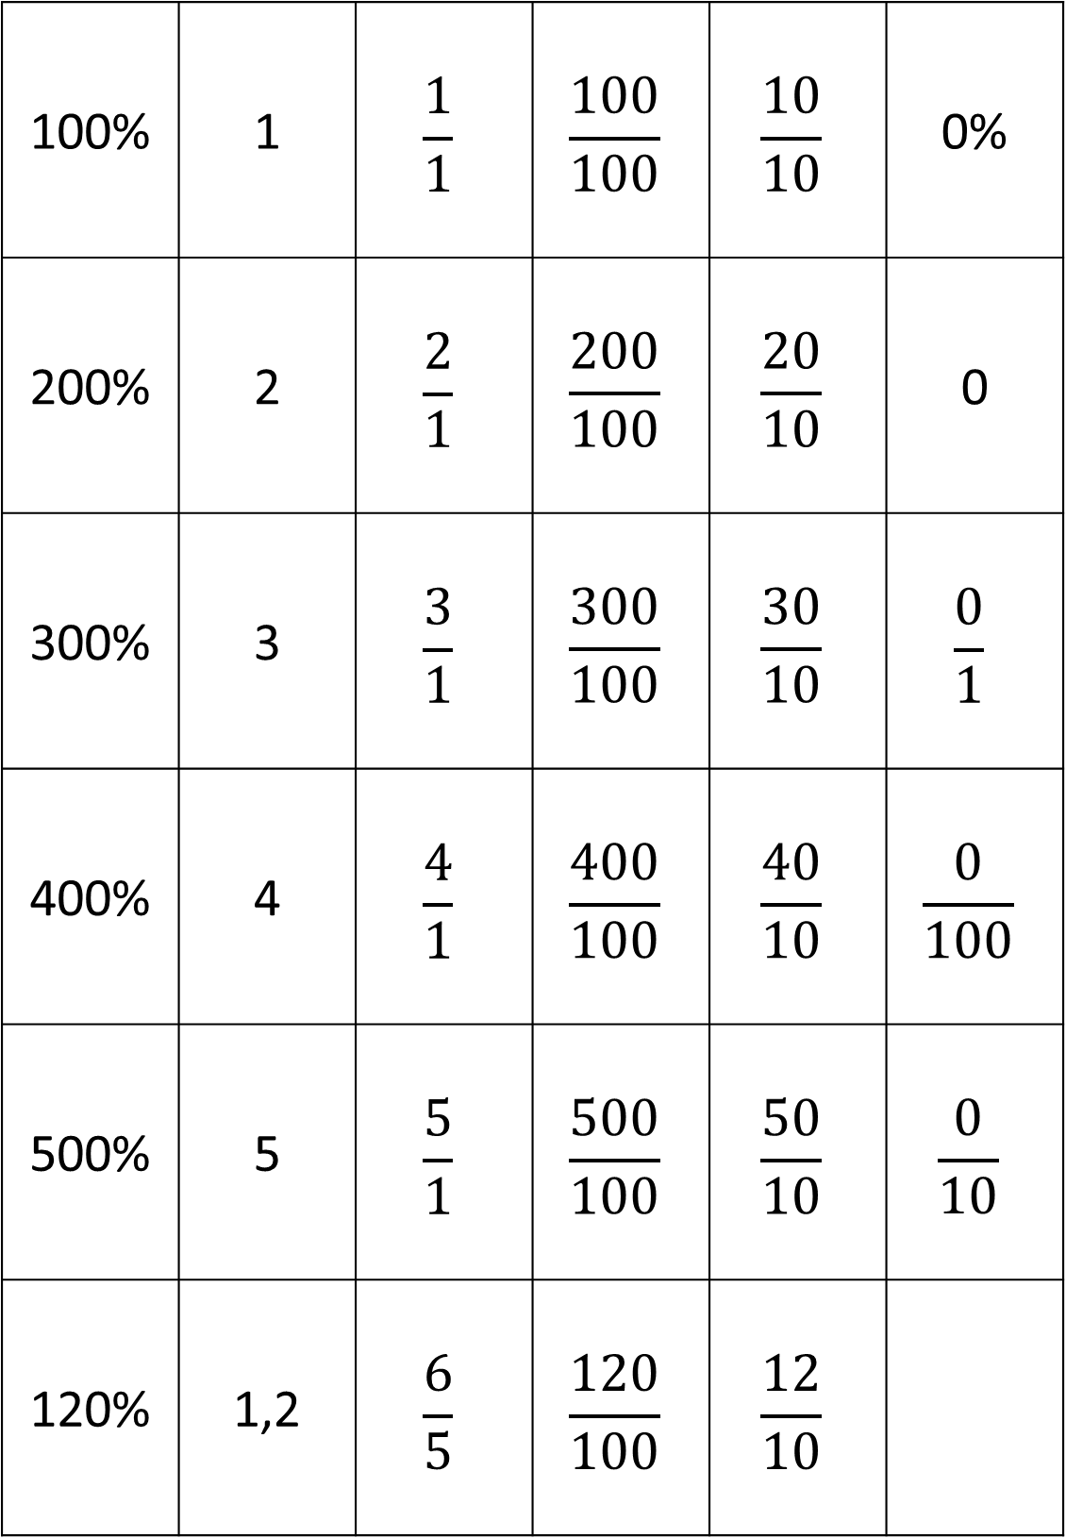
100% | 1 | $$\frac{1}{1}$$ | $$\frac{100}{100}$$ | $$\frac{10}{10}$$ | 0%
200% | 2 | $$\frac{2}{1}$$ | $$\frac{200}{100}$$ | $$\frac{20}{10}$$ | 0
300% | 3 | $$\frac{3}{1}$$ | $$\frac{300}{100}$$ | $$\frac{30}{10}$$ | $$\frac{0}{1}$$
400% | 4 | $$\frac{4}{1}$$ | $$\frac{400}{100}$$ | $$\frac{40}{10}$$ | $$\frac{0}{100}$$
500% | 5 | $$\frac{5}{1}$$ | $$\frac{500}{100}$$ | $$\frac{50}{10}$$ | $$\frac{0}{10}$$
120% | 1,2 | $$\frac{6}{5}$$ | $$\frac{120}{100}$$ | $$\frac{12}{10}$$

